Slide 1
A Study of Overfitting and Data Augmentation in Image Classification Networks
CS 3337, Group DarkSide
Syed Rizvi
Elisa Martinez
Arno Dunstatter
Sevilay Ozturk
DarkSide Group Project
2
Dr. Christoph Eick
CS 3337

Slide 2
Agenda
Convolutional Neural Networks in Pytorch
Multi-layer CNN architectures, experiments
Regularization Techniques
Data Augmentation
Convolutional Neural Networks in Keras
Additional Neural Network Experiments
Support Vector Machines
Performance on Cifar10
Comparison with Neural Networks
Conclusions
Best performing model
Comparing results between CNNs and SVMs
DarkSide Group Project
2
Dr. Christoph Eick
CS 3337

Slide 3
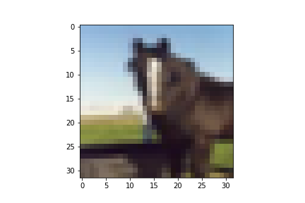
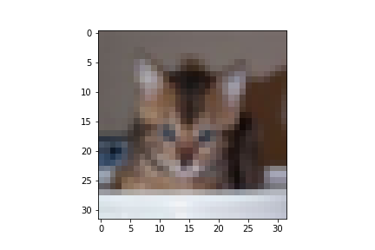
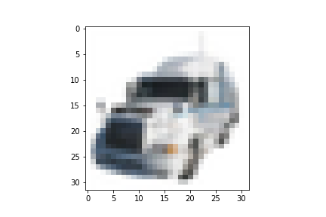
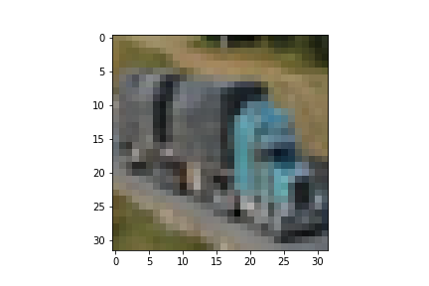
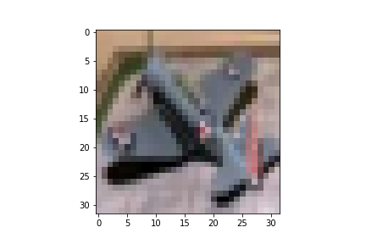
Cifar10
Details
Popular Image Classification Dataset
32x32 pixel resolution
50,000 training images
10,000 test images
10 classes
Krizhevsky, Alex, and Geoffrey Hinton. "Learning multiple layers of features from tiny images." (2009): 7.
DarkSide Group Project
3
Dr. Christoph Eick
CS 3337

Slide 4

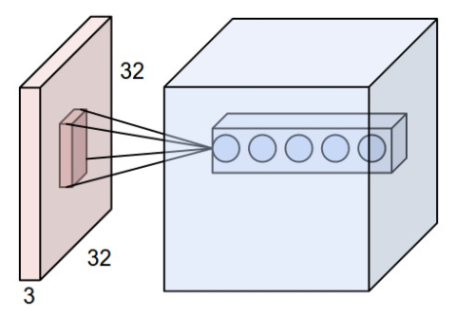
Convolutional Neural Networks
VGG 16 Network
Convolution
Simonyan, Karen, and Andrew Zisserman. "Very deep convolutional networks for large-scale image recognition." arXiv preprint arXiv:1409.1556 (2014).
DarkSide Group Project
4
Dr. Christoph Eick
CS 3337
Notes:
Figures:
https://www.jeremyjordan.me/convnet-architectures/
https://cs231n.github.io/convolutional-networks/

Slide 5
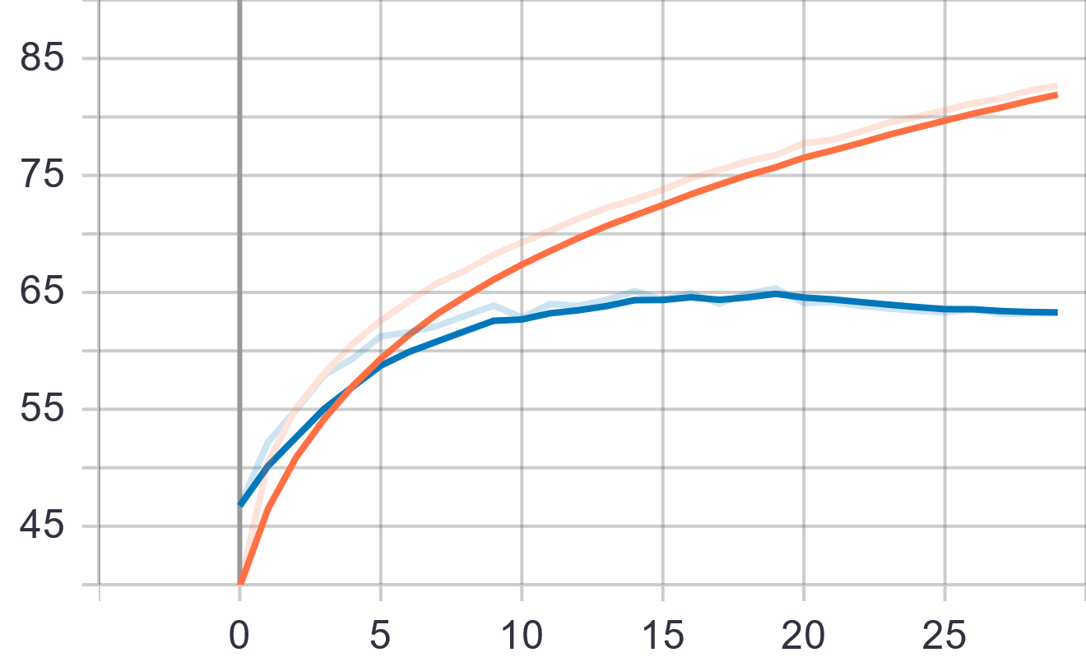
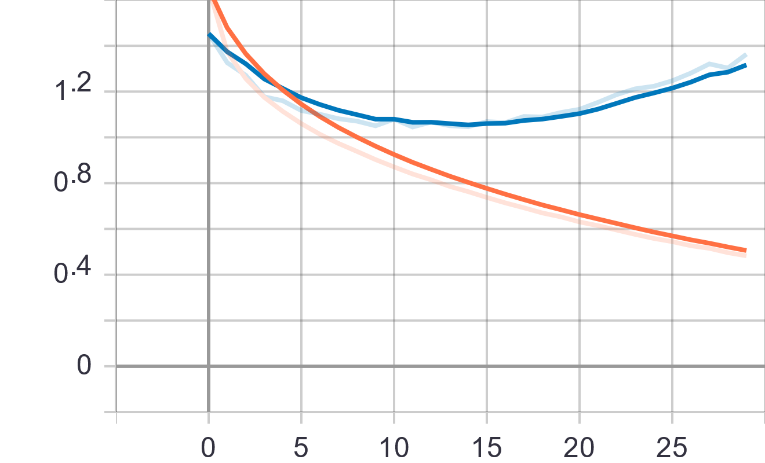
Overfitting Issue
Accuracy vs Epochs (training, validation)
Loss vs Epochs (training, validation)
DarkSide Group Project
5
Dr. Christoph Eick
CS 3337
Notes:
Figures:
https://www.jeremyjordan.me/convnet-architectures/
https://cs231n.github.io/convolutional-networks/

Slide 6

Accuracy vs Epochs (training, validation)
2 Layer CNN
Training Details
Learning rate 0.0003
Batch size 16, ReLU activations
30 epochs
No augmentations
Architecture
Loss vs Epochs (training, validation)
Convolution, Pooling, Fully connected
DarkSide Group Project
6
Dr. Christoph Eick
CS 3337

Slide 7
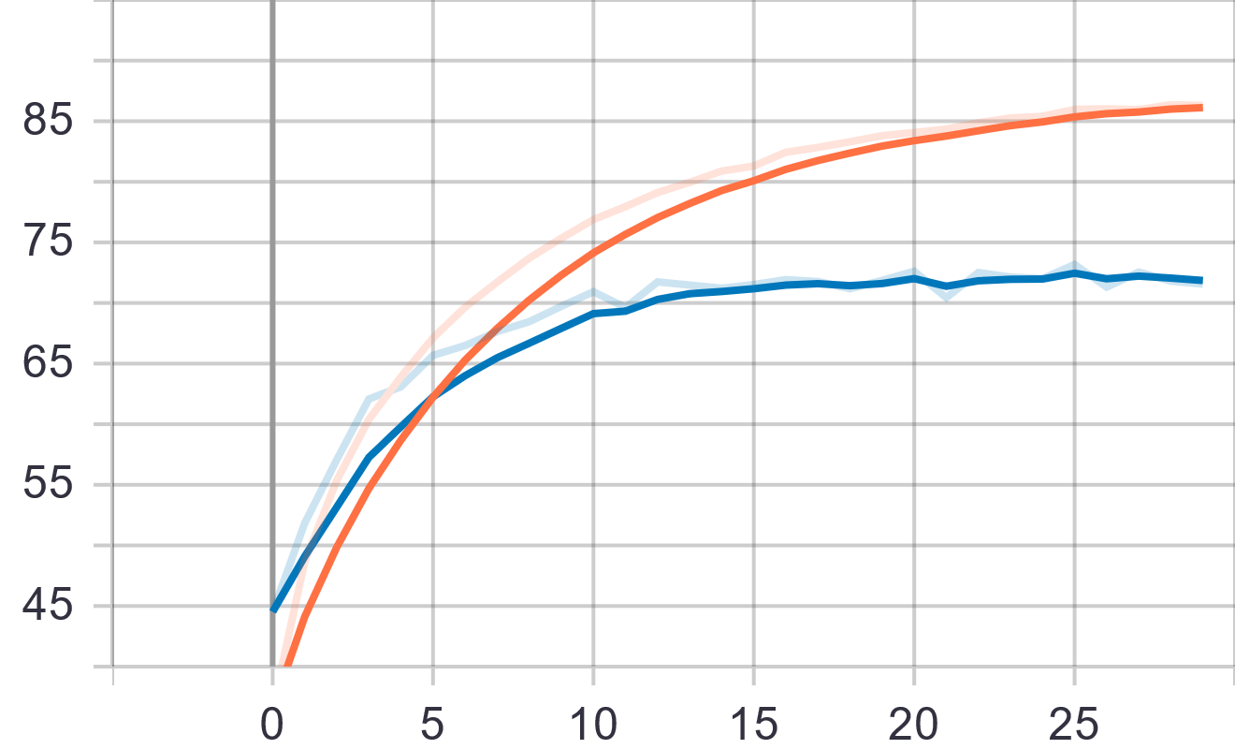
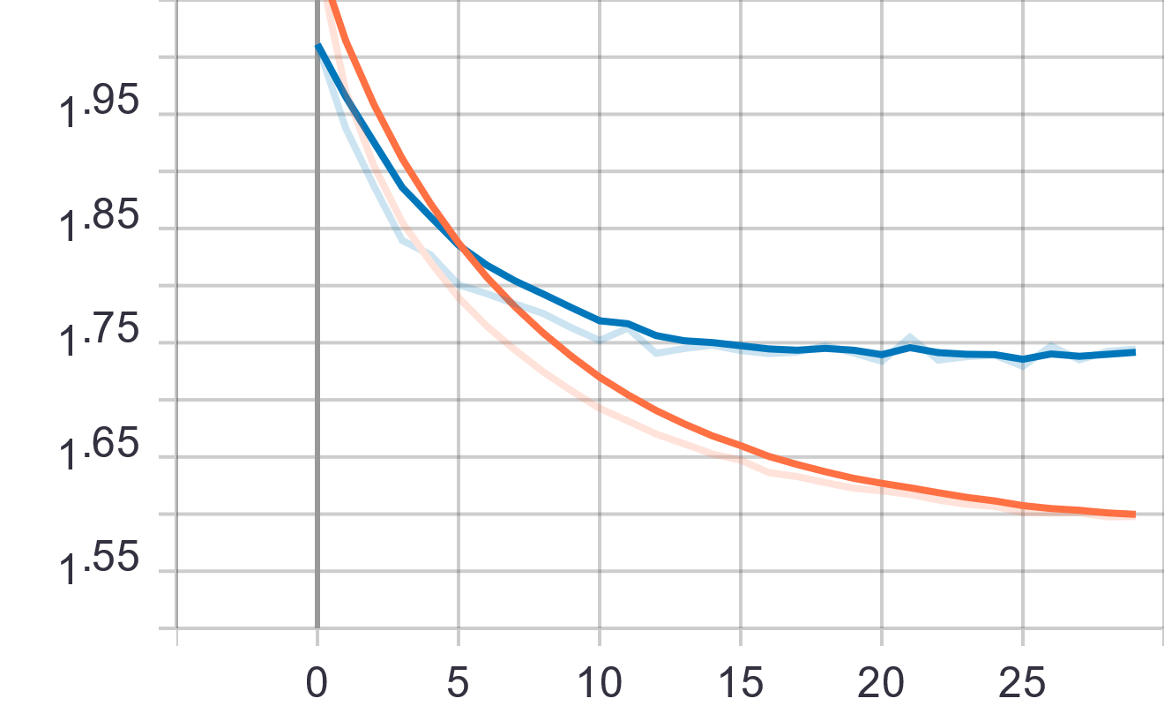
Accuracy vs Epochs (training, validation)
4 Layer CNN
Training Details
Learning rate 0.0003
Batch size 16, ReLU activations
30 epochs
No augmentations
Architecture
Loss vs Epochs (training, validation)
Convolution, Pooling, Fully connected
DarkSide Group Project
7
Dr. Christoph Eick
CS 3337

Slide 8
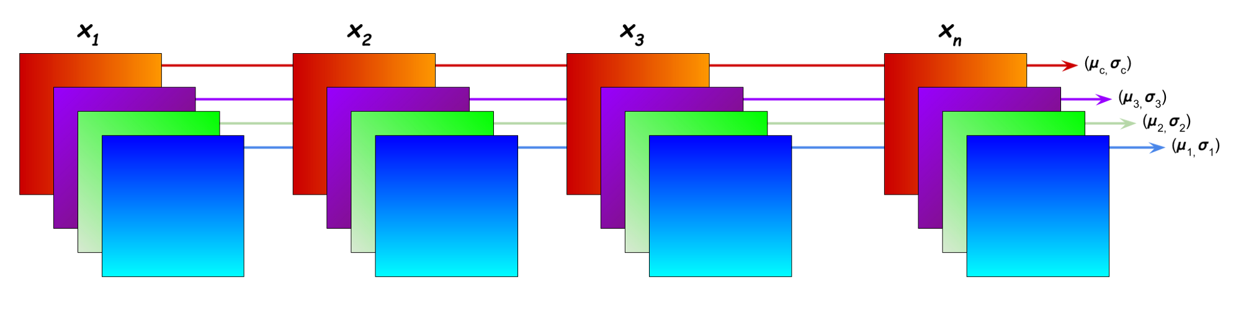
Input Distribution
Batch Normalization
Process
Shift activations by mean, scale by standard dev. => mean of 0, unit dev.
Benefits
Speeds up training, allows higher learning rate
Provides some regularization, easier weight initialization
0
Ioffe, Sergey, and Christian Szegedy. "Batch normalization: Accelerating deep network training by reducing internal covariate shift." International conference on machine learning. PMLR, 2015.
DarkSide Group Project
8
Dr. Christoph Eick
CS 3337
Notes:
Figures:
https://becominghuman.ai/all-about-normalization-6ea79e70894b

Slide 9
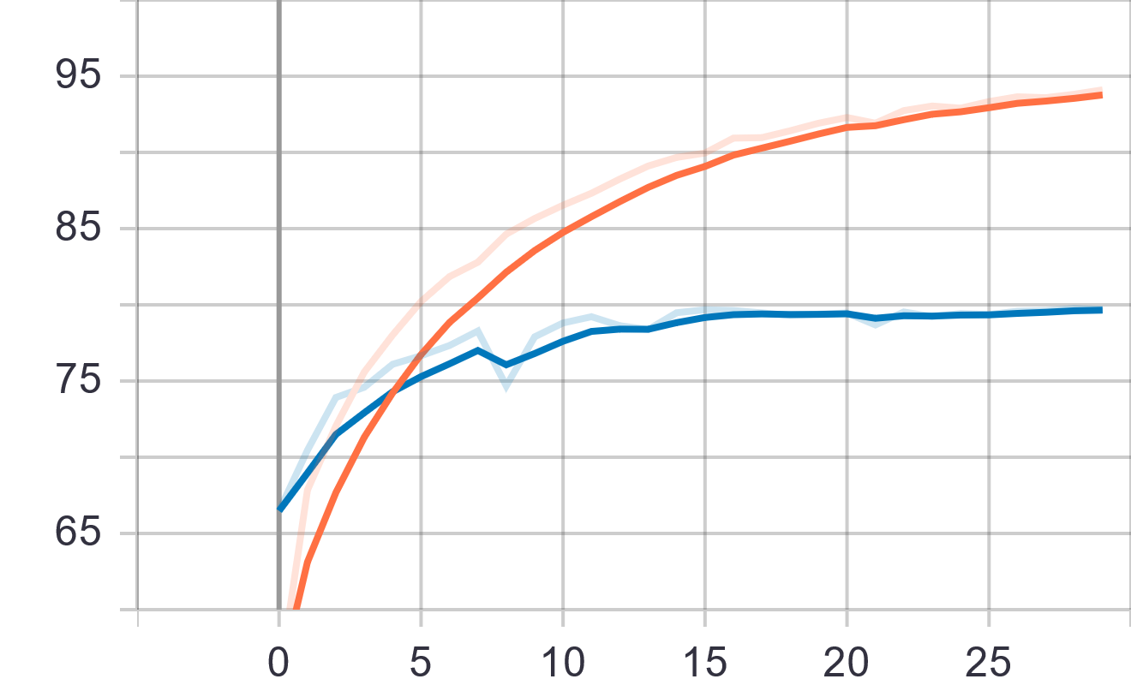
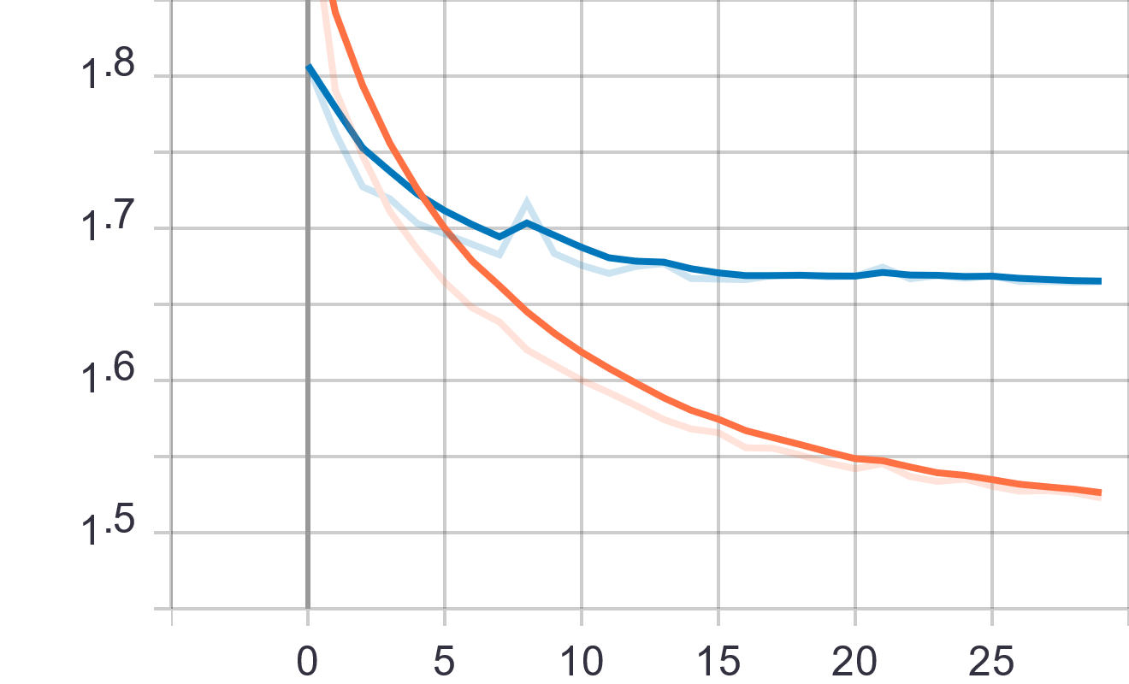
Accuracy vs Epochs (training, validation)
4 Layer CNN + Batch Norm
Training Details
Learning rate 0.0003
Batch size 16, ReLU activations
30 epochs
Batch normalization after convolutions
Architecture
Loss vs Epochs (training, validation)
2x
Convolution, Batch Norm, Pooling, Fully connected
DarkSide Group Project
9
Dr. Christoph Eick
CS 3337

Slide 10
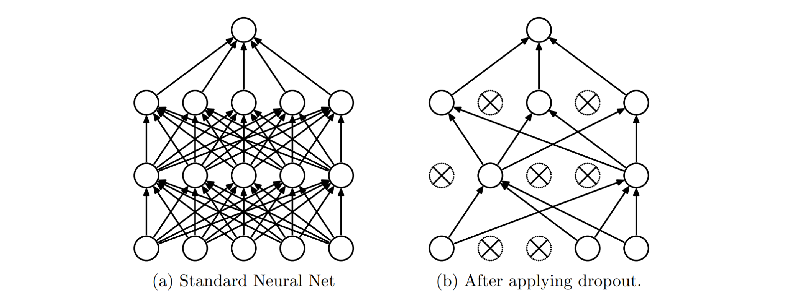
Dropout
Benefits/Intuition
Regularization, less overfitting. Simulate many different networks predicting
Srivastava, Nitish, et al. "Dropout: a simple way to prevent neural networks from overfitting." The journal of machine learning research 15.1 (2014): 1929-1958.
DarkSide Group Project
10
Dr. Christoph Eick
CS 3337
Notes:
Figure:
https://www.jmlr.org/papers/volume15/srivastava14a/srivastava14a.pdf

Slide 11
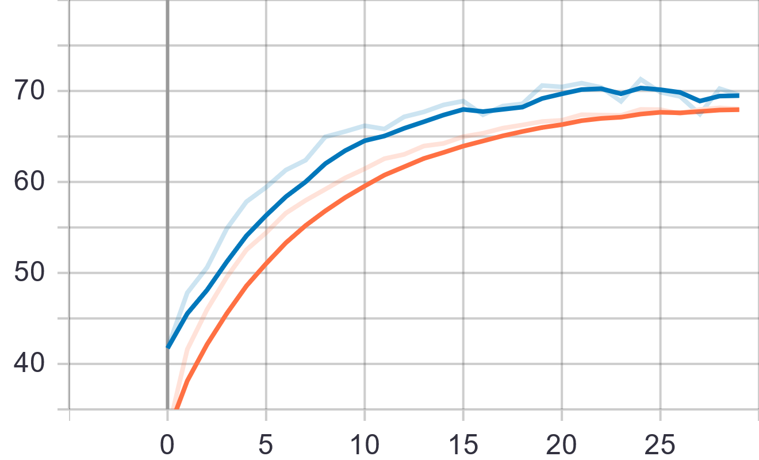
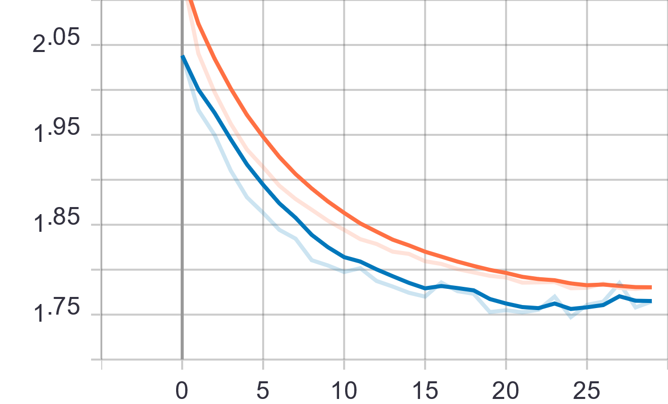
Accuracy vs Epochs (training, validation)
4 Layer CNN + Dropout
Training Details
Learning rate 0.0003
Batch size 16, ReLU activations
30 epochs
Dropout after convolution/pooling blocks
Architecture
Loss vs Epochs (training, validation)
2x
Convolution, Pooling, Dropout, Fully connected
DarkSide Group Project
11
Dr. Christoph Eick
CS 3337

Slide 12
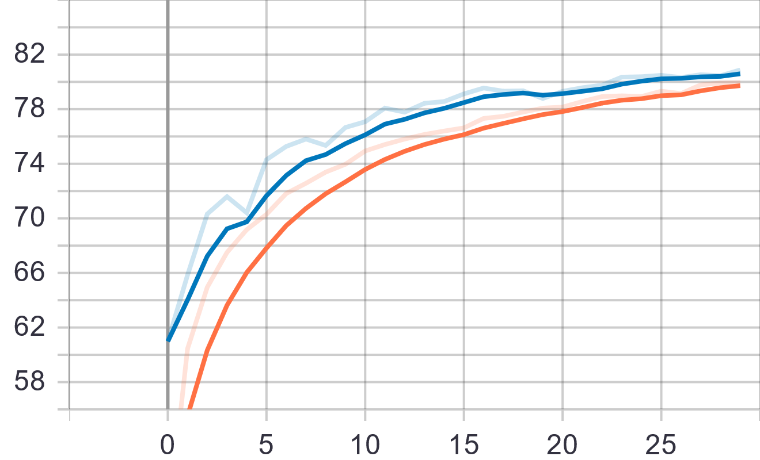
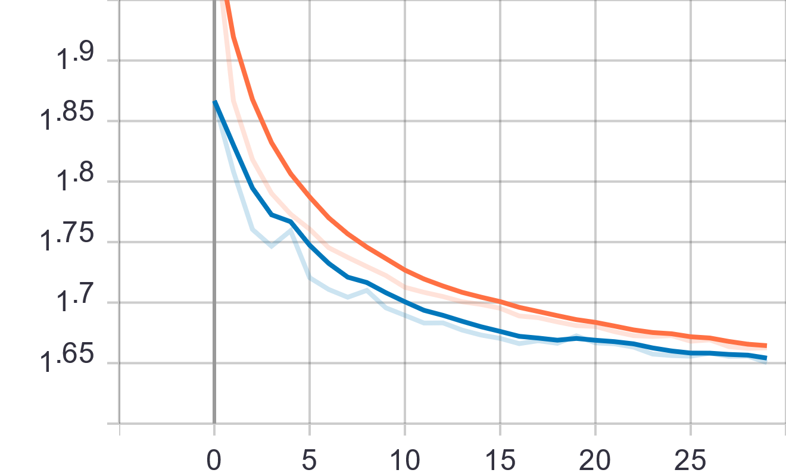
Accuracy vs Epochs (training, validation)
4 Layer CNN + Batch Norm
+ Dropout
Training Details
Learning rate 0.0003, 30 epochs
Batch size 16, ReLU activations
Batch Norm and Dropout present
Architecture
2x
Loss vs Epochs (training, validation)
Convolution, Batch Norm, Pooling, Dropout, Fully connected
DarkSide Group Project
12
Dr. Christoph Eick
CS 3337

Slide 13
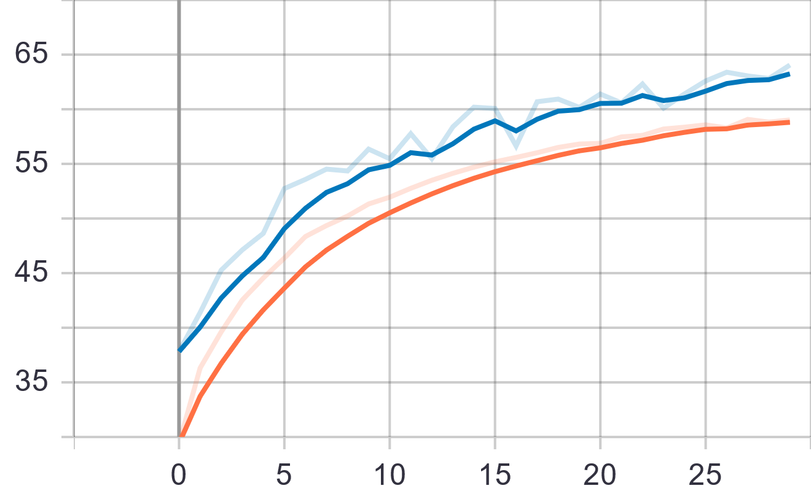
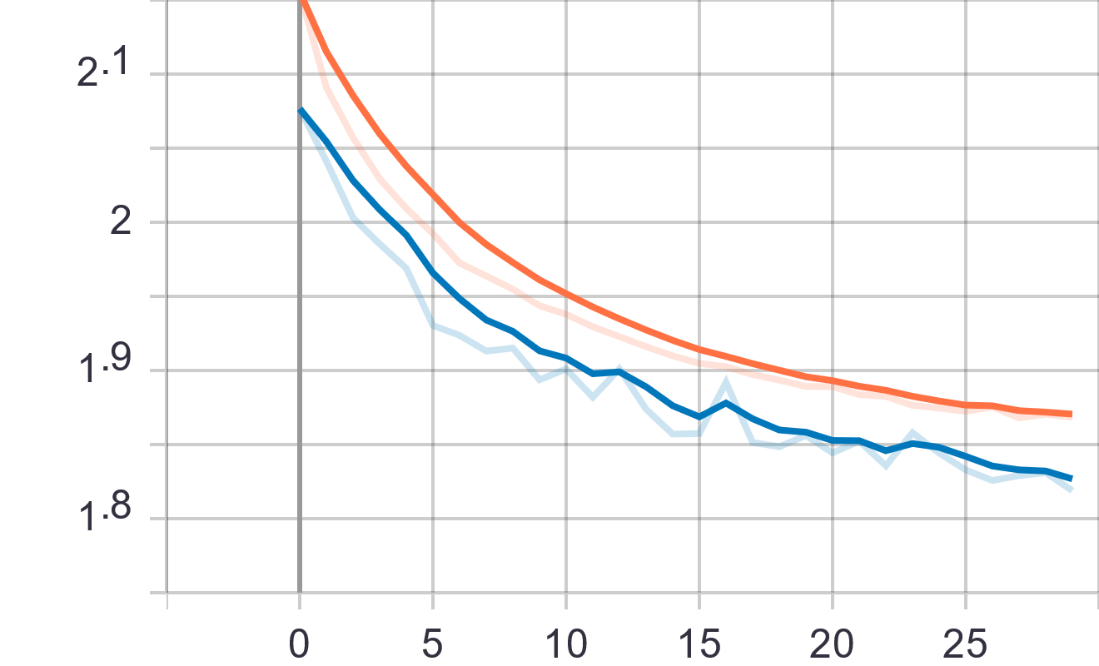
Accuracy vs Epochs (training, validation)
4 Layer CNN +
Regular Augmentations
Training Details
Learning rate 0.0003
Batch size 16, ReLU activations
30 epochs, simple augmentations
Architecture
Loss vs Epochs (training, validation)
Augm.
Convolution, Pooling, Fully connected
DarkSide Group Project
13
Dr. Christoph Eick
CS 3337

Slide 14
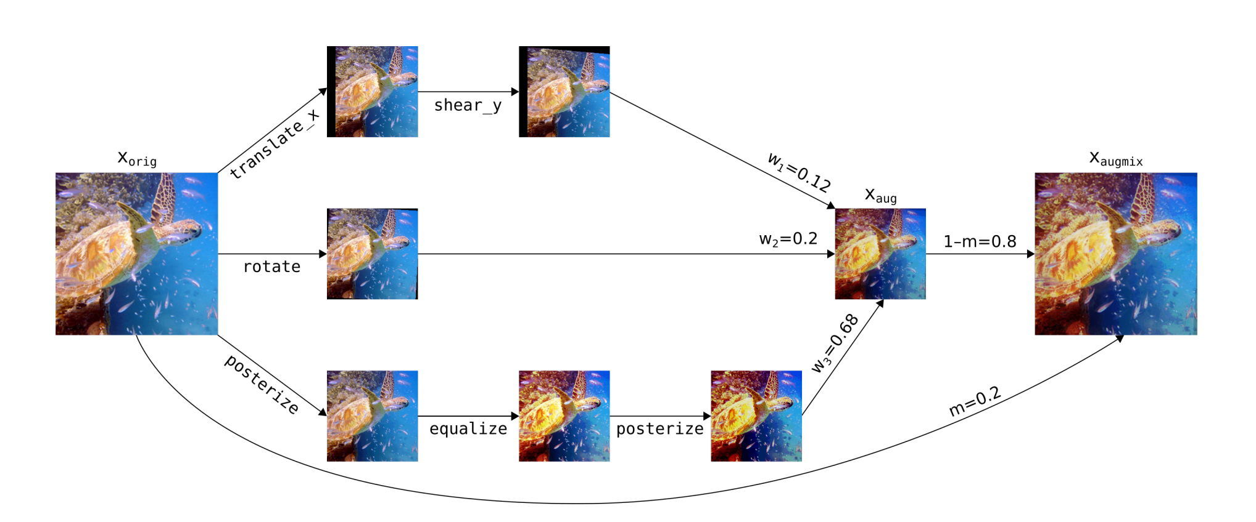
AugMix
*JSD Consistency loss
Hendrycks, Dan, et al. "Augmix: A simple data processing method to improve robustness and uncertainty." arXiv preprint arXiv:1912.02781 (2019).
CS 3337
14
Dr. Christoph Eick
CS 3337

Slide 15
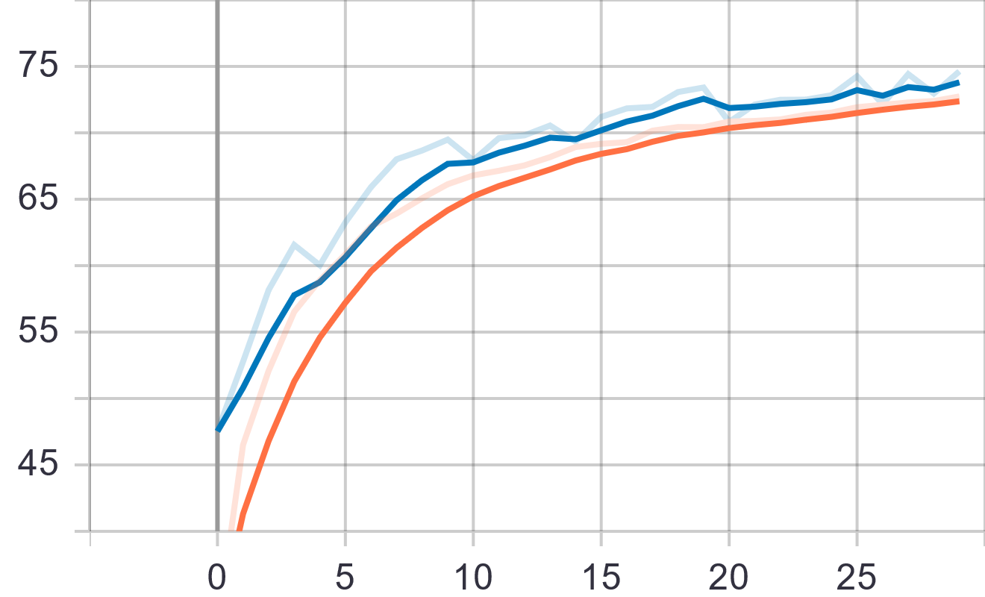
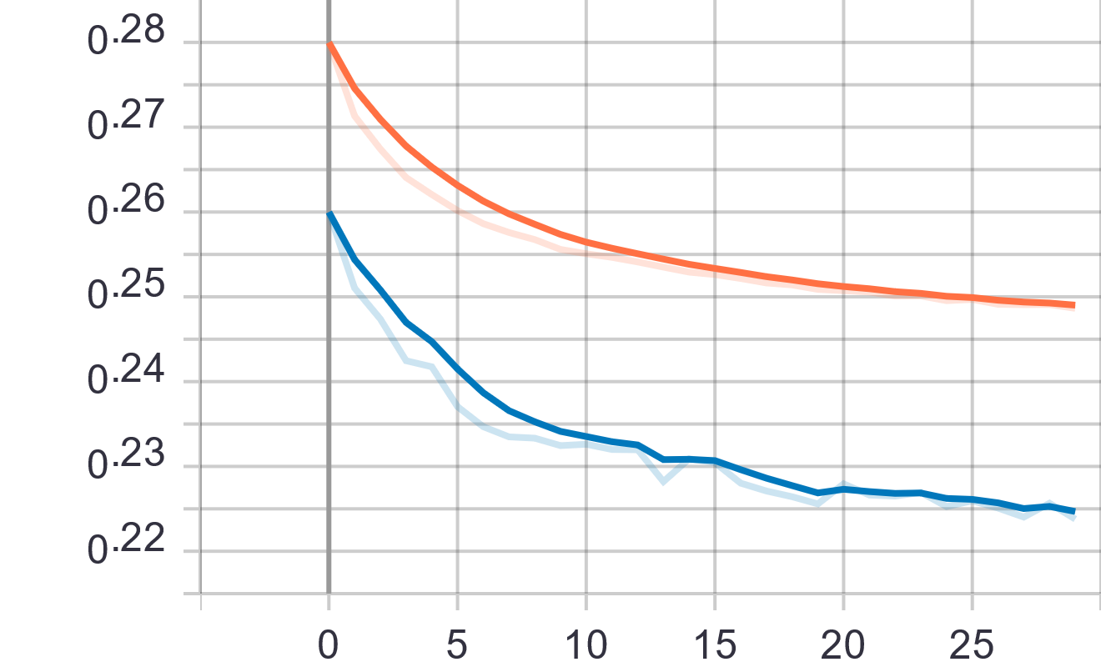
Accuracy vs Epochs (training, validation)
4 Layer CNN + AugMix
Training Details
Learning rate 0.0003
Batch size 16, ReLU activations
30 epochs
No augmentations
Architecture
Loss vs Epochs (training, validation)
AugMix
Convolution, Pooling, Fully connected
DarkSide Group Project
15
Dr. Christoph Eick
CS 3337

Slide 16
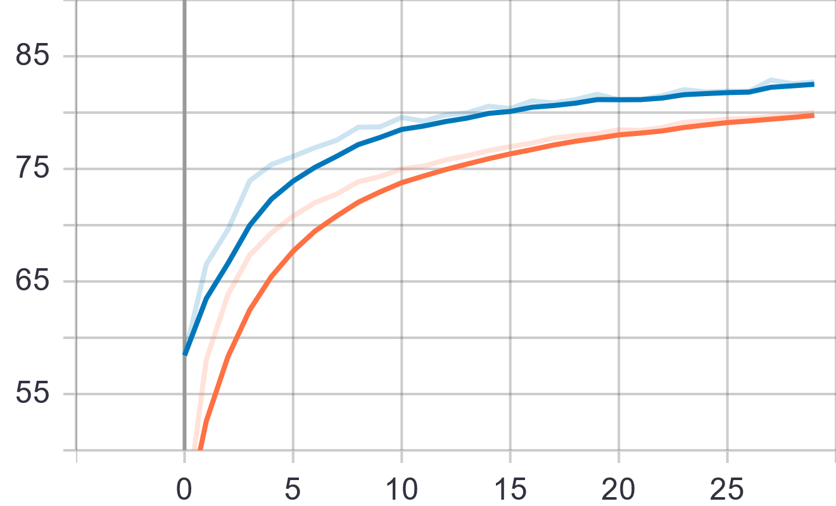
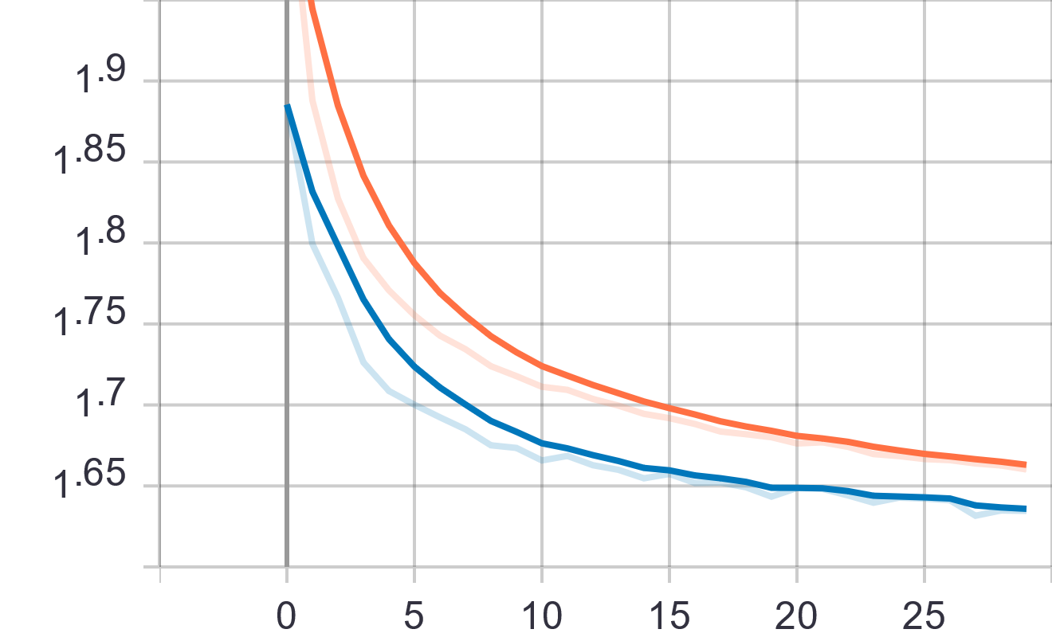
Accuracy vs Epochs (training, validation)
6 Layer CNN + Batch Norm
Dropout
Training Details
Learning rate 0.0003
Batch size 16, ReLU activations
30 epochs
Architecture
Loss vs Epochs (training, validation)
3x
Convolution, Batch Norm, Pooling, Dropout, Fully connected
DarkSide Group Project
16
Dr. Christoph Eick
CS 3337

Slide 17

Convolutional Neural Networks in Keras
Additional Neural Network Experiments
Keras is a high-level API capable of running on top of TensorFlow, CNTK, Theano, or MXNet (or as tf.contrib within TensorFlow). Since its initial release in March 2015, it has gained favor for its ease of use and syntactic simplicity, facilitating fast development. It’s supported by Google.
DarkSide Group Project
17
Dr. Christoph Eick
CS 3337

Slide 18
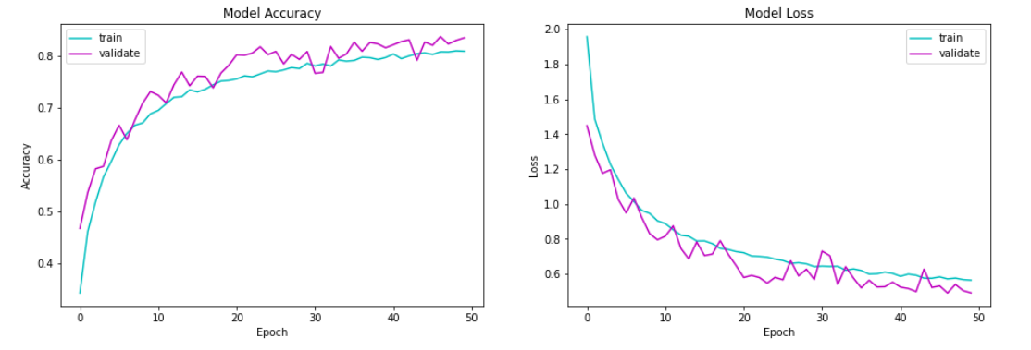
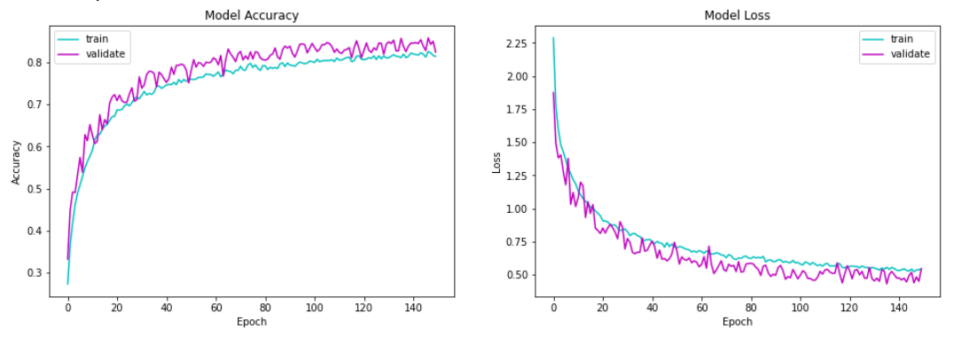
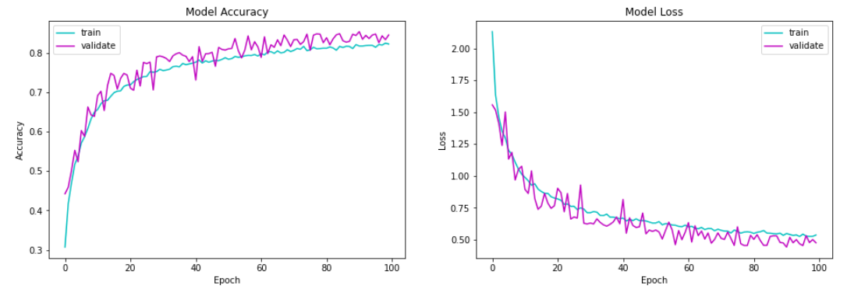
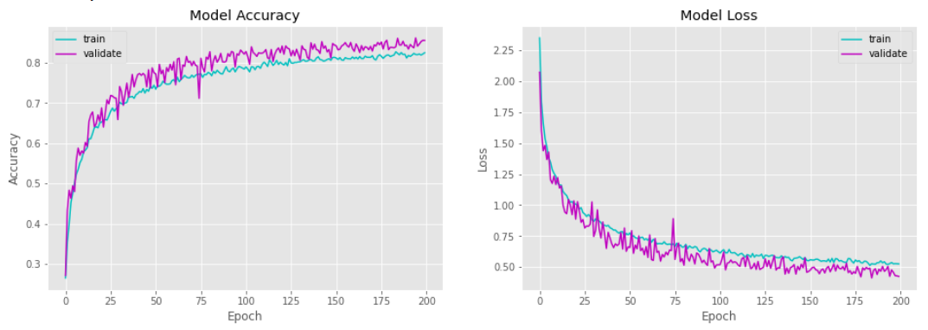
Additional CNN Experiments performed with Keras
Training Details: 3 layers, 50 epochs, 32 batch size, adam optimizer
Results: 83.46% validation accuracy and 80.89% training accuracy
Training Time: 51min 24s
Training Details: 3 layers, 150 epochs, 100 batch size, adam optimizer
Results: 82.39% validation accuracy and 81.37% training accuracy
Training Time: 1h 10min 35s
Training Details: 3 layers, 100 epochs, 64 batch size, adam optimizer
Results: 84.49% validation accuracy and 82.20% training accuracy
Training Time: 1h 16min 45s
Training Details: 3 layers, 200 epochs, 128 batch size, adam optimizer
Results: 85.62% validation accuracy and 82.55% training accuracy
Training Time: 1h 6min 43s
DarkSide Group Project
16
Dr. Christoph Eick
CS 3337
Notes:
Considering the results of the pytorch experiments we started with a simple custom 3-layer CNN using the Sequential class to group a linear stack of layers to a keras model.

Slide 19
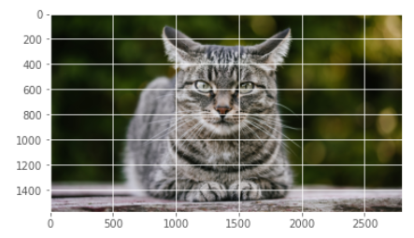
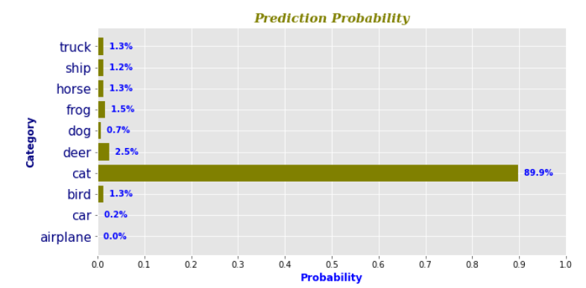
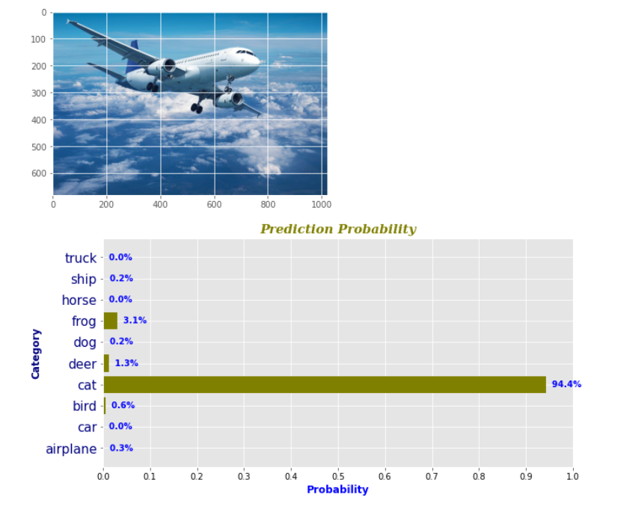
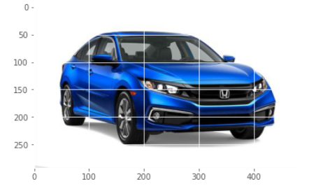
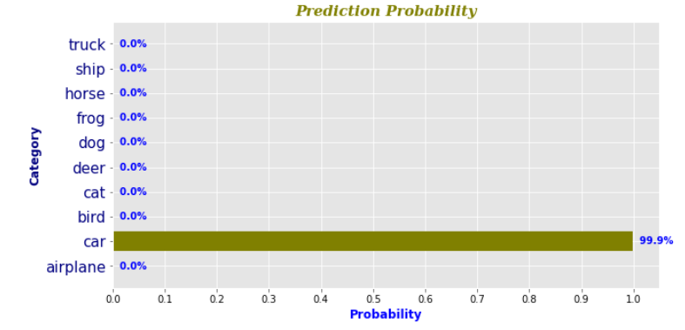
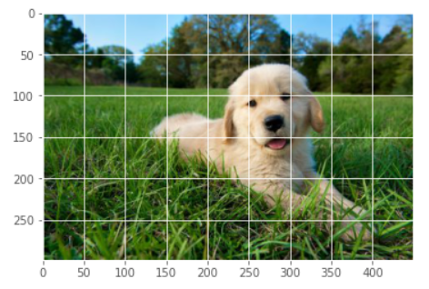
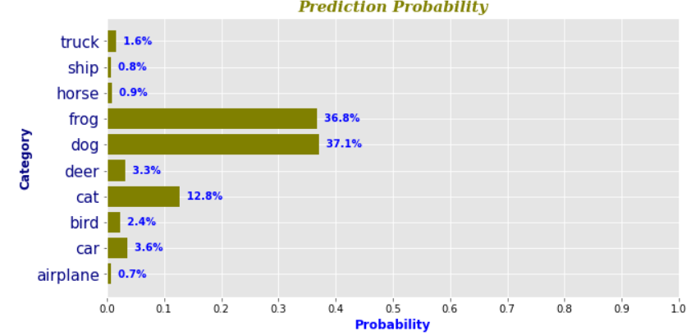
How does image classifier trained on cifar10 predicts on random images of plane/cats/cars.
DarkSide Group Project
16
Dr. Christoph Eick
CS 3337
Notes:
How does image classifier trained on cifar10 predict/perform on random images of dogs/cats/cars taken from google images,

Slide 20
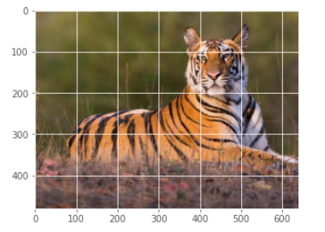
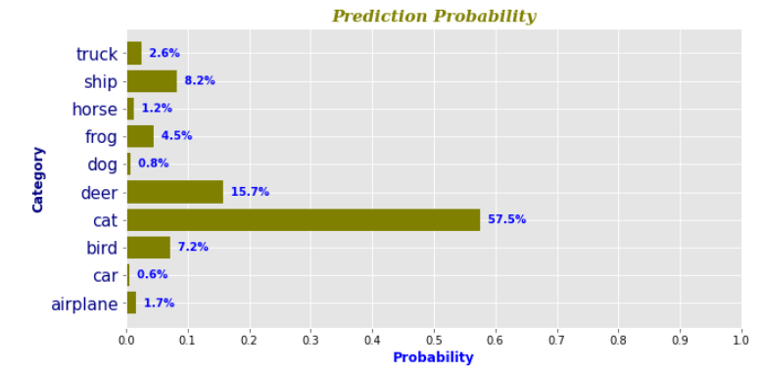
What does it predict when you give the image classifier an object that is not one of the 10 classes?
DarkSide Group Project
16
Dr. Christoph Eick
CS 3337
Notes:
What does it predict when you give the image classifier an object that is not one of the 10 classes?

Slide 21
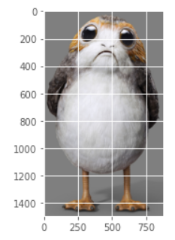
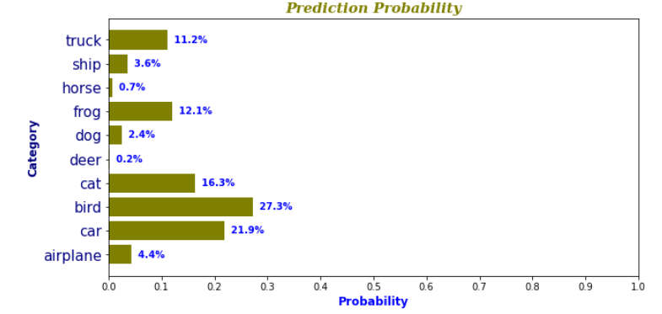
What does it predict when you give the image classifier an object that is not one of the 10 classes?
DarkSide Group Project
16
Dr. Christoph Eick
CS 3337
Notes:
What does it predict when you give the image classifier an object that is not one of the 10 classes?

Slide 22
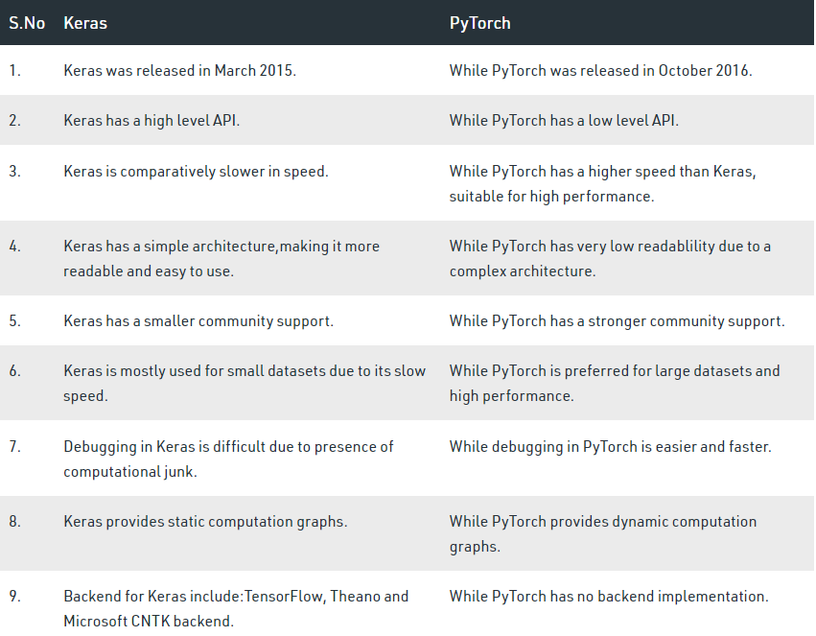
Keras vs Pytorch
Researchers favor Pytorch over Keras.
DarkSide Group Project
17
Dr. Christoph Eick
CS 3337
Notes:
Keras it’s a high-level API focused Library which has a bigger community than Pytorch, but the latter is easier to debug, has better training speeds, and gives you more insights on how the science of it works. Pytorch is more like doing python coding and if you want to implement your own neural network layers, PyTorch is the tool for you.
Researchers favor Pytorch over Keras.

Slide 23
How good are Support Vector Machines at this same classification task?
DarkSide Group Project
17
Dr. Christoph Eick
CS 3337
Notes:
We wanted to get a general idea of how SVMs would stack up against NNs when it came to this task. To this end two SVMs were produced, trained, and tested.

Slide 24
Two different types of SVMs were examined
Linear SVMs were trained with various batch counts and various epoch counts
Two non-linear SVMs were trained - one with only 1/5th the training data, one with all of the training data
DarkSide Group Project
18
Dr. Christoph Eick
CS 3337
Notes:
Linear SVMs were trained with various batch counts and various epoch counts
Because these models work best on data that has a mean and unit variance of 0 we normalized using sklearn’s StandardScaler preprocessing function which performs z-scoring
A non-linear SVM was trained with 1 big batch
Uses a radial basis function kernel to project data into higher dimensions
Normalized with sklearn’s MinMaxScaler preprocessing function

Slide 25
Linear SVMs with mini-batches
First hyper-parameter tunings cycled through combinations of
EPOCHS = [1, 10, 20, 40, 80]
BATCHES = [5, 10, 25, 50, 100]
Best result was ~39% accuracy with Epoch count = 10 and Batch count = 100
Second hyper-parameter tunings cycled through combinations of
EPOCHS = [5, 10, 15]
BATCHES = [100, 500, 1000]
Best result was still only ~39% accuracy, this time with Epoch count = 5, Batch count = 500
DarkSide Group Project
16
Dr. Christoph Eick
CS 3337
Notes:
Since no significant improvement in performance was observed between tunings, no further tuning was performed.

Slide 26
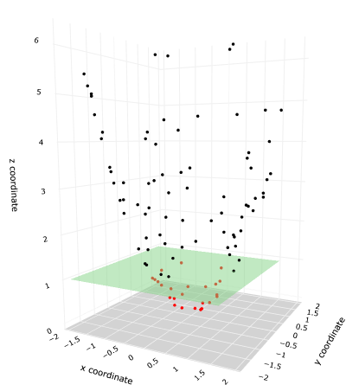
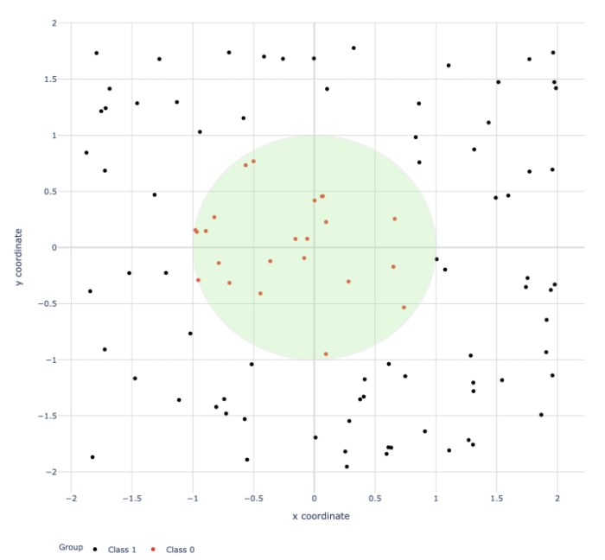
Non-linear SVMs with one batch gradient descent
When trained with only 1/5th the training set an accuracy of ~47% was achieved.
Training took ~5 minutes
When trained with the whole training set an accuracy of ~54% was achieved.
Training took ~3.25 hours
Transformed using a "kernel trick" such that the red and black classes are now linearly separable with a hyperplane.
DarkSide Group Project
16
Dr. Christoph Eick
CS 3337
Images: https://towardsdatascience.com/svm-classifier-and-rbf-kernel-how-to-make-better-models-in-python-73bb4914af5b
Notes:
Significantly better than any linear SVM trained with mini-batches but still no match for the neural networks.

Slide 27
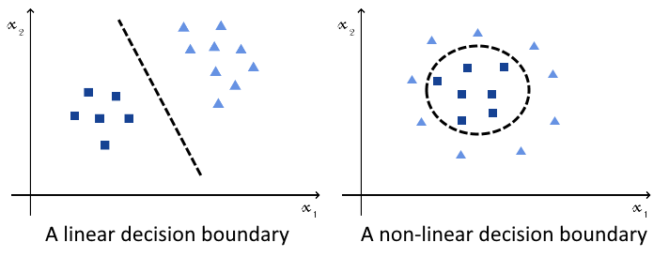
Why Did Neural Networks Outperform SVMs?
Differences between methods play a big role
SVMs use subset of a data for training on the other hand CNNs use batches of data that feed into it, this causes SVMs to perform not as well because the decision to use the set for training data is not as accurate as the batch decision for CNNs. Another point is that deep CNNs always have higher complexity than SVMs since number of parameters for SVMs increase linearly. Furthermore, while SVMs performed worse they were able to produce non-trivial results (47% accuracy) when trained in just 5 minutes with only ⅕ of the data set used to train the CNNs; essentially trading accuracy for speed of training and reduced training set size.
DarkSide Group Project
16
Dr. Christoph Eick
CS 3337

Slide 28
Accuracy vs Epochs (training, validation)
Conclusions
Best Performance on Cifar 10 Dataset
6-layer CNN + Batch Normalization + Dropout
Low overfitting
Fast training (~30 minutes)
No data augmentation required
Best Regularizers
Dropout
Data Augmentation
Convolutional Neural Networks
vs SVMs
CNNs achieve higher performance
CNNs have more flexible architectures
SVMs achieve decent performance, have
different training setup
3x
Convolution, Batch Norm, Pooling, Dropout, Fully connected
DarkSide Group Project
16
Dr. Christoph Eick
CS 3337

Slide 29
References
Citations
Krizhevsky, Alex, and Geoffrey Hinton. "Learning multiple layers of features from tiny images." (2009): 7.
Krizhevsky, Alex, Ilya Sutskever, and Geoffrey E. Hinton. "Imagenet classification with deep convolutional neural networks." Advances in neural information processing systems 25 (2012): 1097-1105.
Ioffe, Sergey, and Christian Szegedy. "Batch normalization: Accelerating deep network training by reducing internal covariate shift." International conference on machine learning. PMLR, 2015.
Srivastava, Nitish, et al. "Dropout: a simple way to prevent neural networks from overfitting." The journal of machine learning research 15.1 (2014): 1929-1958.
Hendrycks, Dan, et al. "Augmix: A simple data processing method to improve robustness and uncertainty." arXiv preprint arXiv:1912.02781 (2019).
Liu, Yangguang, Qinming He, and Qi Chen. "Incremental batch learning with support vector machines." Fifth World Congress on Intelligent Control and Automation (IEEE Cat. No. 04EX788). Vol. 2. IEEE, 2004.
Luca, Gabriele De. “SVM vs Neural Network.” Baeldung on Computer Science, 25 Aug. 2021, .
Code Repositories
https://github.com/google-research/augmix
DarkSide Group Project
16
Dr. Christoph Eick
CS 3337

